Slide 1
Tagged Release Version
Meeting October 29, 2024

Slide 2
What do we need to do?
I need to read once more through the manual
Someone else should do a hands-on run-through of the manual and verification examples
I will add some Tecplot post-processing examples to the manual:
Slices e.g. GWF saturations
Calculating new values in Tecplot e.g. pressure head=z-elevation
Isosurfaces (e.g. water table)
Value blanking
The verification examples chapter needs to be finalized
Index entries could be improved
Update the repositories and create a tagged release e.g. Version 2024.month (tagged bug fixes and updates would be 2024.1, 2024.3…..)

Slide 3
Verification Examples

Slide 4
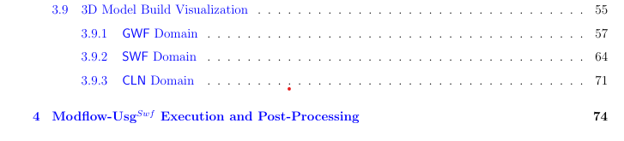
Manual
Recently added sections:

Slide 5
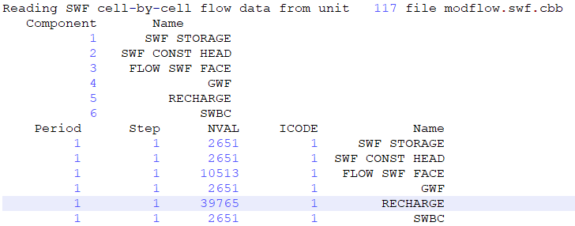
Known issues
No velocity vectors
SWF Recharge is writing nCells GWF number of values to cbb file and they are all zero. This is from abdul _posto.eco file:

Slide 6
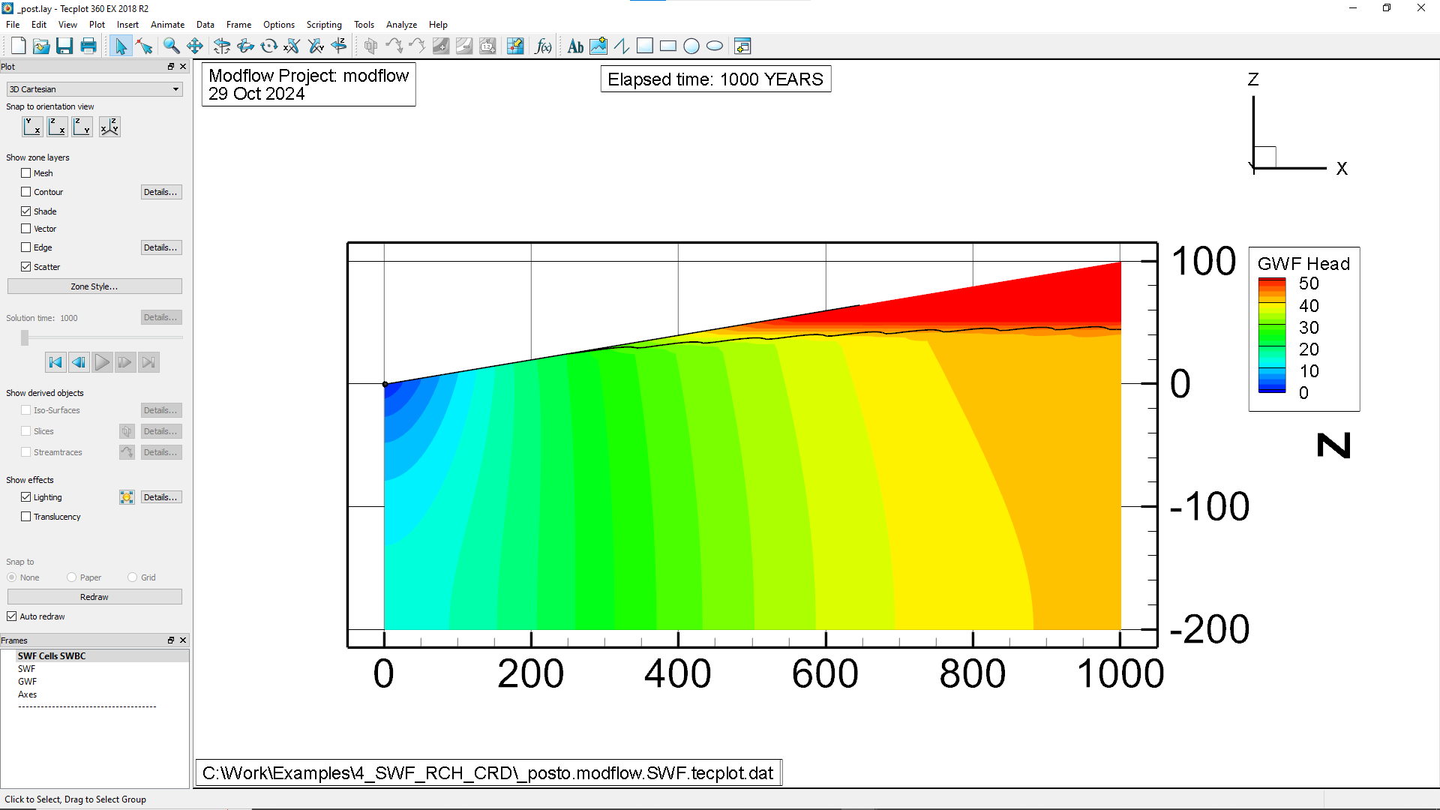
Verification example: 4_SWF_RCH_CRD
Humps in water table
Non-zero surface water depth extends upslope now

Slide 7
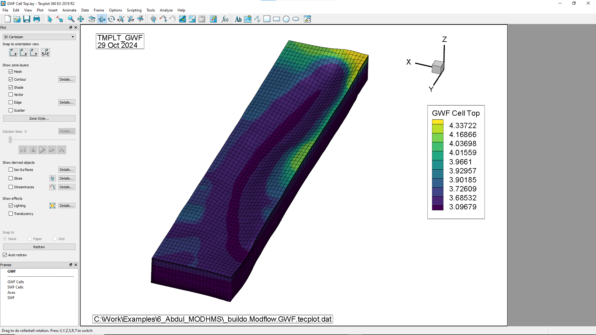
Verification example: 6_Abdul_MODHMS
X-axis reversed compared to Abdul

